Slide 1

Logistic regression
BY:-Apoorv Khare
JIIT NOIDa

Slide 2
History of Logistic Regression
Logistic Regression's history can be traced back to the 19th century when it was first used to describe the growth rate of populations by Quetelet and Verhulst. Today, logistic regression is widely used in the field of medicine and biology. Epidemiology is also an area where logistic regression is widely used for identification of risk factors for diseases and to plan for preventive medication. Studies concerned with public health and related policy decisions use logistic regression as an important statistical tool.

Slide 3
What is LOGISTIC REGRESION
Logistic regression is a classification algorithm used to assign observations to a discrete set of classes. Unlike linear regression which outputs continuous number values, logistic regression transforms its output using the logistic sigmoid function to return a probability value which can then be mapped to two or more discrete classes.

Slide 4
Types Of Logistic Regression
Binary (Pass/Fail)
Multi (Cats, Dogs, Sheep)
Ordinal (Low, Medium, High)

Slide 5
Binary Logistic Regression
Say we’re given data on student exam results and our goal is to predict whether a student will pass or fail based on number of hours slept and hours spent studying. We have two features (hours slept, hours studied) and two classes: passed (1) and failed (0).
Here the classification will have two classes with values as 0 and 1 , hence the name binary classification

Slide 6
Multinomial-logistic Regression
Multinomial logistic regression is used to model nominal outcome variables, in which the log odds of the outcomes are modeled as a linear combination of the predictor variables.
Instead of y=0,1 we will expand our definition so that y=0,1...n. Basically we re-run binary classification multiple times, once for each class.

Slide 7
Ordinal Logistic Regression
Ordinal logistic regression (often just called 'ordinal regression') is used to predict an ordinal dependent variable given one or more independent variables. It can be considered as either a generalization of multiple linear regression or as a generalization of binomial logistic regression. As with other types of regression, ordinal regression can also use interactions between independent variables to predict the dependent variable.

Slide 8


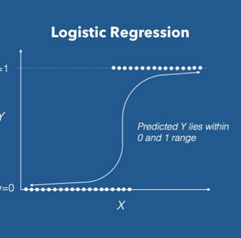
Graph Of Logistic Regression

Slide 9
Understanding the maths behind it!!!
The outcome in binomial logistic regression can be a 0 or a 1. The idea is then to estimate the probability of an outcome being a 1 or a 0. Given that the probability of the outcome being a 1 is given by p then the probability of it not occurring is given by 1-p. This is a special case of Binomial distribution called the Bernoulli distribution.
The idea in logistic regression is to cast the problem in form of generalized linear regression model.
y^=β₀+β₁x₁+…+β _{n}x_{n}
where y^=predicted value, x= independent variables and the β are coefficients to be learnt.

Slide 10
w^{T}=[β₀,β₁,…,β_{n}]…………………………………………………………(2)
x^{T}=[1,x₁,…,x_{n}]…………………………………………….………………(3)
Then
y^=w^{T}x……………………………………………...…(4)
odds(p)= (p/1−p)………………………………………………………(5)
That can be done by getting the (natural) logarithm of the odds as:
logit(p)=log(p/1−p)……………………………………………………(6)
This now varies continuously linear and thus we can do the following:
logit(p)=y^=w^{T}x………………………………………………………….(7)

Slide 11
Thus the logit function acts like a link between logistic regression and linear regression and thus it is called a link function.
We then take the inverse of logit to get the probability p as given below:
logit(p)=log(p/1−p)………………………………………………………………(8)
Taking the natural exponential on both sides gives:
e^{logit(p)}=p/1−p……………………………………………..(9)
Then adding 1 on both sides gives:
e^{y^} + 1=(p/1−p)+1………………………………………………………………..(10)
e ^{y^} +1= 1/1−p ……………………………………………………………………….(11)

Slide 12
Changing subject of formula to 1-p gives:
1−p=1/e ^{y^} +1………………………………………………………………………..(13)
Then subtracting 1 from both sides to give:
−p=(1/e ^{y^} +1) −1……………………………………………………………………………………… (14)
Multiply by -1 on both sides to get:
p=1−1ey^+1……………………………………………………………………………………………..(15)
p=e^{y^} /e ^{y^} +1…………………………………………………………………………………….........(16)
Then divide the numerator and denominator by e^{y^} to get:
p=1/1+e−y^……………………………………………………………………………………………………………….....(17)
Looks familiar?

Slide 13

Estimation of Regression Coefficients
Unlike linear regression model, that uses Ordinary Least Square for parameter estimation, we use Maximum Likelihood Estimation.
Because logistic regression predicts probabilities, rather than just classes, we can fit it using likelihood. For each training data-point, we have a vector of features x_{i}, and an observed class, y_{i}. The probability of that class was either p, if y_{i}=1, or 1−p, if y_{i}=0. The likelihood is then

Slide 14
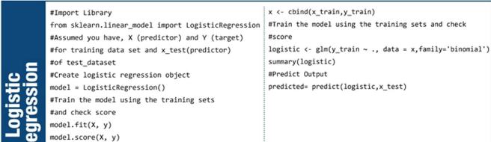
Pseudocode of Logistic Regression

Slide 15
Evaluation OF Model
Model Score
Confusion Matrix
Bias And Variance Calculation

Slide 16
Some Takeaways: Logistic Regression
In Logistic regression, it is not required to have the linear relationship between the dependent and independent variable.
In logistic regression, there should not be collinearity between the independent variable.
Maximum likelihood estimation method is used for estimation of accuracy

Slide 17
Thank YOU!!!

